Slide 1
AI Agents + .NET Aspire

Slide 2

Bruno Capuano
Principal Cloud Advocate
@elbruno | aka.ms/elbruno

Slide 3
Agent
Semi-autonomous software that can be given a goal and will work to achieve that goal without you knowing in advance exactly how it's going to do that or what steps it's going to take.

Slide 4

An agent needs to accomplish 3 things:
Reason over a provided business process
Retrieve context to complete the process
Perform an action for the end-user

Slide 5

Azure AI Foundry
Coming Soon
Azure AI Agent Service
Securely build, deploy, and scale AI agents with ease
Rapid development and automation
Extensive data connections
Flexible model selection
Enterprise-grade security
ai.azure.com

Slide 6





Semantic Kernel is lightweight, open-source, production-ready, orchestration middleware that lets you easily add AI to your apps.
Python
Java
.NET

Slide 7

Semantic Kernel was built specifically for enterprise app developers.

Slide 8



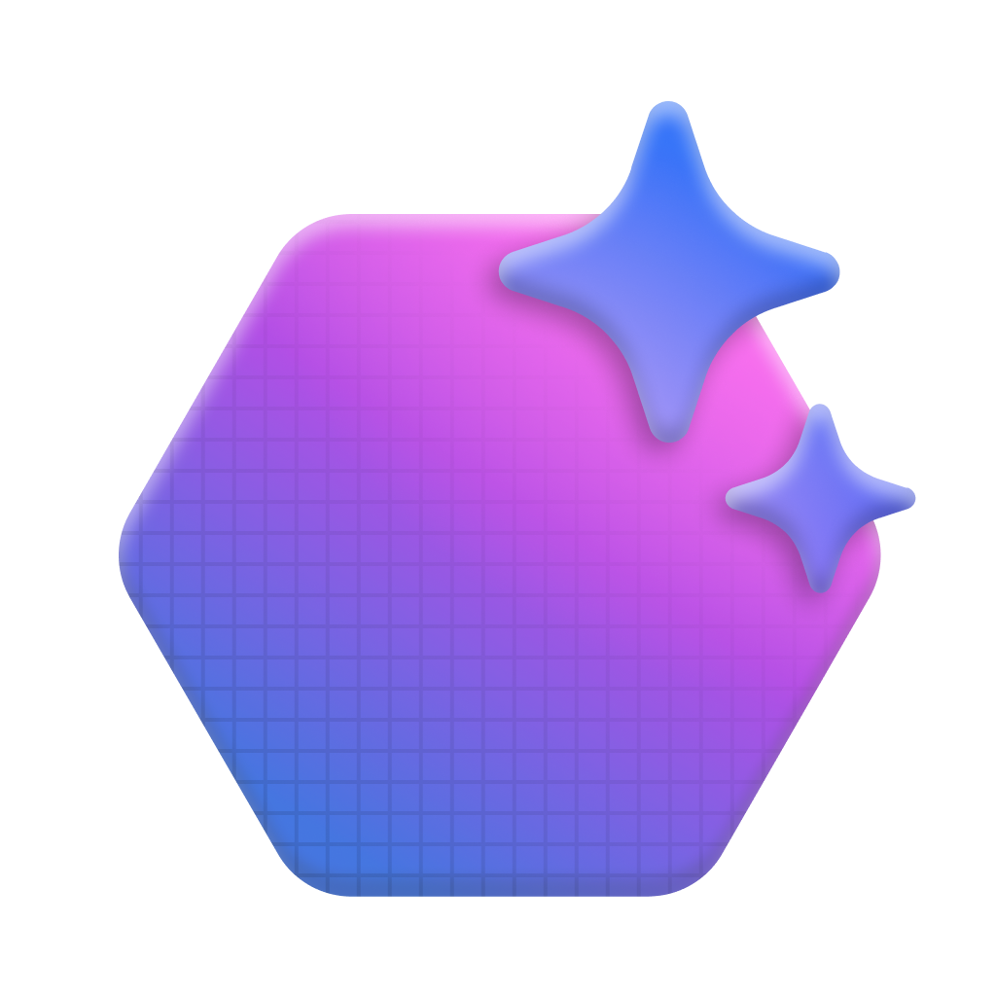

















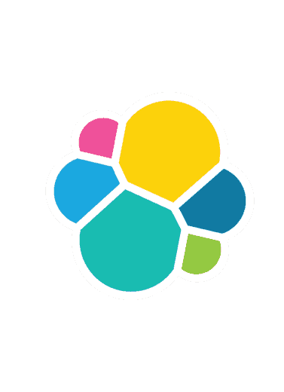








Semantic Kernel AI and Agent Orchestration
AI Services
 | Azure OpenAI |  | Foundry Catalog
 | OpenAI |  | Hugging Face
 | NVIDIA |  | Deepseek
 | Google Gemini |  | AWS Bedrock
Agent Services
 | Azure AI Agent Service |  | Bedrock Agents
 | AutoGen |  | Crew AI
Plugins
 | OpenAPI |  | MCP
 | Container Apps |  | Logic Apps
Local models
 | Ollama |  | ONNX
 | LM Studio |  | Phi SLM Model Family
Prompts
 | YAML |  | Semantic Kernel
Memory Services
 | Azure AI Search |  | Azure CosmosDB
 | Elasticsearch
 | MongoDB |  | Pinecone
 | Qdrant |  | Redis
Filters and telemetry
 | OpenTelemetry |  | Azure Monitor
 | Aspire Dashboard |  | Azure AI Content Safety
Z
.NET
Python
Java

Slide 9




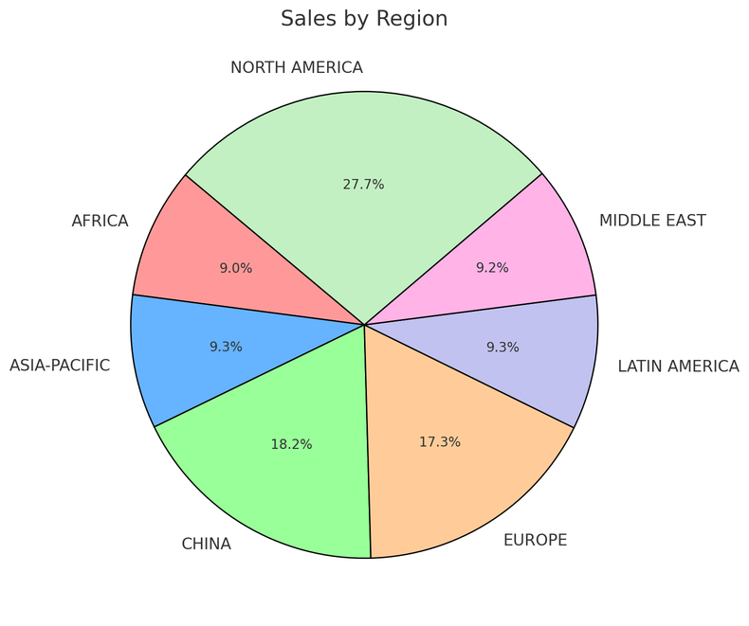
AI Agent in Action
Step 1: Create an Agent
Step 2: Create a Thread
Step 3: Run the Agent
Step 5: Check the Run status
Step 6: Display the Agent’s Response
Agent
Contoso Sales Agent
Instructions: You are an advanced sales analysis agent for Contoso, specializing in assisting users with sales data inquiries
Thread
Sales analysis
Run 1
User’s message
Tell me the total sales by region
1
Function Calling Tool
Query SQLite DB
Model
Agent’s message
Here is the sales:
Europe: $15478.00
America: $78792.00
2
Create message
Your data (optional)
Azure AI Search
Files (local or Azure Blob)
User’s message
Show as a pie chart
Run 2
Tools (optional)
File Search Code Interpreter
Function Calling Bing Search Microsoft SharePoint
Microsoft Fabric
Azure AI Search Azure Logic Apps
Azure Functions
OpenAPI 3.0 specified tools
1
Code Interpreter Tool
Create a pie chart
Agent’s message
2
Create message

Slide 10





Demo: Contoso Creative Writer
Azure Monitor
Multiagent flow
Researcher agent
Azure OpenAI Service
Grounding with Bing
Azure AI Search
Products agent
User Input
Azure Container Apps (ACA)
Response
Azure OpenAI Service
Azure AI Search
Writer agent
Azure OpenAI Service
Editor agent
Azure OpenAI Service
https://aka.ms/creative-writer-agent/net/repo

Slide 11
DEMO
Creative Writer Agents - .NET

Slide 12
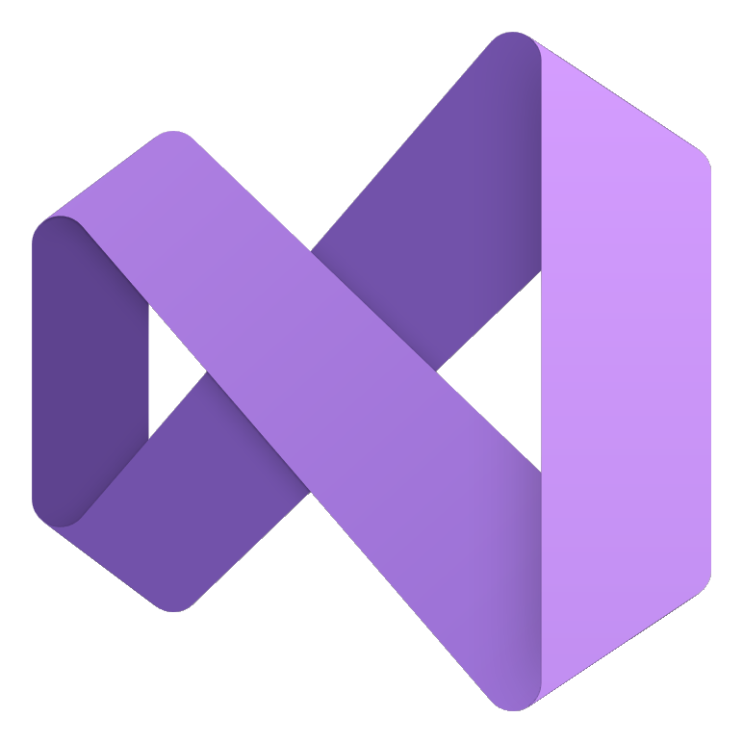








Build anything with a unified platform
.NET
Cloud
Web
Desktop
Mobile
Gaming
IoT
AI
+
+
Visual Studio
Visual Studio Code
CLI
Linux
NuGet
GitHub
Components, tools, library vendors
Windows
macOS
Tools
Operating system
Ecosystem

Slide 13
Cloud Native
Observability
Resiliency
Scalability
Manageability

Slide 14
Cloud Native
Problems to solve
Complex
Getting Started
Choices
Paved Path

Slide 15
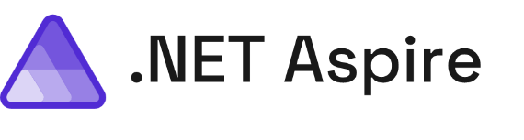
.NET Aspire Includes…
Your building blocks for app development
Smart Defaults
Developer Dashboard
Orchestration
Service Discovery
Integrations
Deployment

Slide 16
DEMO
Let’s Aspire this thing!

Slide 17
Demo: Contoso Creative Writer
Azure Monitor
Multiagent flow
Researcher agent
Azure OpenAI Service
Grounding with Bing
Azure AI Search
Products agent
User Input
Azure Container Apps (ACA)
Response
Azure OpenAI Service
Azure AI Search
Writer agent
Azure OpenAI Service
Editor agent
Azure OpenAI Service
https://aka.ms/creative-writer-agent/net/repo

Slide 18
DEMO
Let’s Aspire this thing!

Slide 19
Next steps

Slide 20

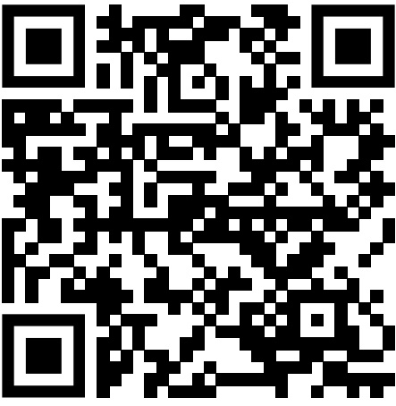
Generative AI for Beginners - .NET
A course for .NET developers diving into the world of Generative AI! This repository is all about real-world applications and live coding to empower .NET developers to take full advantage of Generative AI.
Start in less that 5 minutes here:
aka.ms/genainet

